Slide 1

Branch Diver Lectures

Slide 2
Version History – hidden slide
Version | Date | Who | What changed
2.0 | Sep06 | HQ | Released Version Sport Diver Lecture 12 – SSAC Organisation
3.0 | Jun12 | HQ | Updated for revised HQ address and contact details
4.0 | Apr14 | Alastair McCulloch | Updated to reflect new Training Schedule with addition of Branch Diver Grade. Lecture renumbered to match the new syllabus. SSAC changed to ScotSAC throughout. Added hidden version history slide. Email address for feedback added to closing slide. Added footers with Lecture number and Page number to slides.

Slide 3
Lecture BDL1
ScotSAC Organisation
and its Training Programme

Slide 4
Overview
ScotSAC Background
The History of Diving
National Organisation
Branch Organisation
Training Programme
Diving Rules
Diver Grades
ScotSAC Resources

Slide 5
ScotSAC Background
Scottish Sub Aqua Club
Founded in 1953 - one the oldest amateur diving organisations in the world
1300 members in Scotland, Northern England & Ireland
More than 60 active branches
Governing body for the sport in Scotland
True amateur status
Outstanding safety record
Funded by member subscriptions and sportscotland.

Slide 6
The History of Diving
Diving bells and diving helmets were first used underwater in the 16th century.
In 1865 a French low pressure tank of 40 bar was designed. Later, French pioneer underwater photographer Louis Boutan produced an air cylinder to 200 bar
French Navy officers, Yves Le Prieur and Jacques Cousteau, designed the first regulator in the 1920s
At the same time Hans Hass and an American Guy Gilpatric were using old flying goggles as diving masks
March 1953 Graham Holborn, Jim Campbell and Tom Lochrey start the first Dive club in Scotland (Govan Sub-Aqua Club) or was it the first in U.K.

Slide 7
National Structure
Board
National
Dive Council
NDO
NDC Members
Chairman
Treasurer
National
Coach
Regional
Coaches
Secretary
Editor
Others
Examiners

Slide 8
Branch involvement
Branches
National
Coach
Board
Examiners
National
Diving
Council
Regional
Coaches
Club
Administrator

Slide 9
National Organisation
Governed nationally by two specific groups:
  Board of Directors: executive management, development and administration
  National Diving Council: training, diving and safety matters
Members of the Board are elected for 3 years and Members of NDC are elected annually. Both from ordinary club members
Club Administrators based at headquarters
  Caledonia House
  1 Redheugh Rigg, South Gyle
  Edinburgh EH12 9DQ
  Tel/fax: 0131 625 4404
  email: hq@scotsac.com.

Slide 10
National Diving Council (NDC)
NDC are responsible for ALL training and instruction, awards and endorsements
NDC elected each year through nomination / postal ballot
NDO chairs the NDC
NDC appoint National Coach and Regional Coaches
National Coach, Regional Coaches and Examiners are ex-officio members of NDC
NDO also member of Board

Slide 11
Branch Organisation
Branches and Members are key to the Organisation
Control of own finances
ScotSAC training programme delivered via branches
Governed by the Branch Committee which includes the Branch Diving Officer
Branches offer the social side of diving

Slide 12
Branch Structure
Branch
Diving Officer
Treasurer
Chairman
Secretary
Others
Branch
Members

Slide 13
Training Programme
Training programme is focused on safety and quality
Progressive, obtainable and paced to suit the individual diver
Training is advanced in a safe manner
Building up experience is as much part of your training as progressing through practical assessments
Incorporates four diver grades and three instructor/examiner grades
Geared to diving in Scottish waters
Qualifications are globally recognised

Slide 14
ScotSAC Diving Rules
ScotSAC diving rules can be found in front of ScotSAC Training schedule. These include:
  Training & diving in Branches shall be carried out as laid down by the club
  No member shall use aqualung in open water unless they can demonstrate good knowledge of lectures and have completed confined open water assessments
  Members of club shall not dive for personal gain
  A qualified instructor must witness all training dives
  No member shall dive deeper than 20m until they have gained their Sport Diver award (and a limit of 15m applies until they have attained the Branch Diver Award)

Slide 15
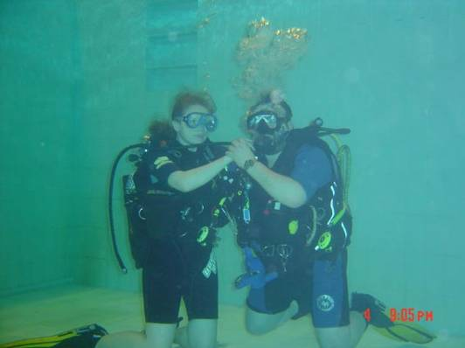
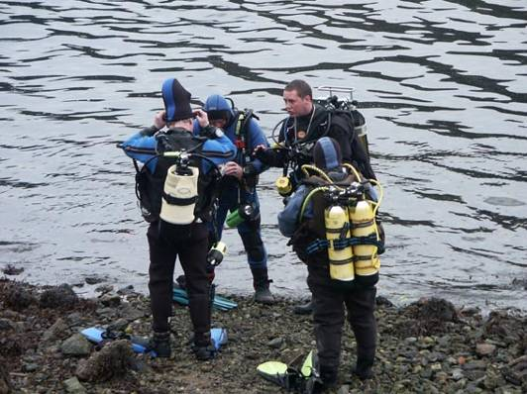
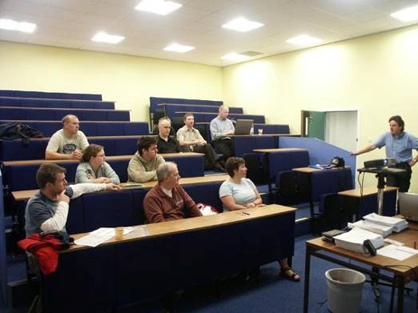
Training Environments
Lecture Training
Pool Training
Open Water Training

Slide 16
Diving Grade Structure
Notes:
Hopefully this slide will make prefect sense it’s the current grade structure
Last changed in July 2000 with the red book
Trainee – Not a formalised qualification – anything from pool trainee to someone nearing Sports Diver
Sports Diver- fair to say the qualification most Branch Divers stick at, described by the Ukrecscuba group as a fairly high entry level qualification.
Recently limited to 30m with exceptions – minimum qual for instructors
Master Diver a fair step from SD to MD and tends to take time to achieve
Complimented by numerous endorsements to enhance the divers experience

Slide 17
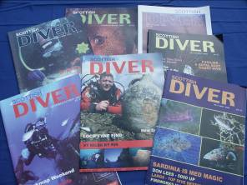
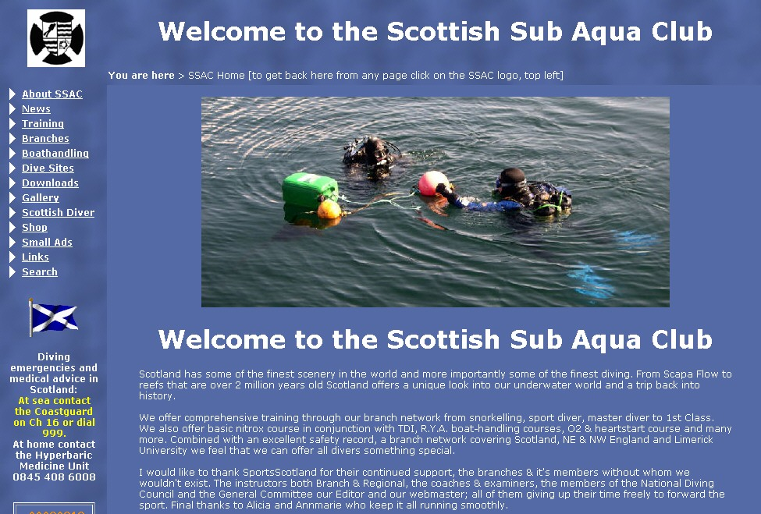
ScotSAC Resources
Scottish Diver
  Bi-monthly magazine, written by members for members
  Contributions welcome from divers of all levels
www.scotsac.com.
  A useful resource for training, information, news and events
Training Material
  Provides a wealth of valuable information

Slide 18
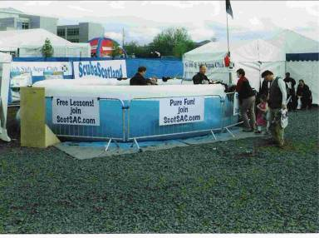
Other resources
Try-Dive Pool
  Portable pool used to promote ScotSAC at many major events throughout the country
Members
  Your fellow members have a wealth of knowledge and experience

Slide 19
Summary
ScotSAC is run by members for members
The future is what you make it
ScotSAC can go from strength to strength with your help - why not introduce a friend?

Slide 20
The End
Thank you for your attention
Any questions?

Slide 21
Please provide any feedback on these slides to hq@scotsac.com
Thanks.

